Slide 1


Department of AIML Engineering
AI REALTIME MONITORING SYSTEM
Under The Guidance of
Prof. M.V.RAUT Prof. S.A.Lavangale
Presented by
Sahil Kurhade Kishor Avhad
Vishal Jadhav
Department of AIML Engineering, LoGMIEER, Nashik
Group_Id : 01

Slide 2


Presentation Outline
Introduction/Objectives
Literature Survey
Problem Statement
Software and Hardware Requirements.
Flowchart
Project Requirement specification
Proposed System Architecture
High level design of the project (DFD , ER Diagrams)
Algorithms
Test Cases
GUI
Project Results
Analysis and Conclusions with future work.
Department of AIML Engineering, LoGMIEER, Nashik
Group_Id : 01

Slide 3

Title
AI REALTIME MONITORING SYSTEM
Department of AIML Engineering, LoGMIEER, Nashik
Group_Id : 01

Slide 4
1. Objectives
Automate student attendance tracking to reduce manual errors and workload.
Enhance campus security through real-time monitoring and incident detection.
Identify unauthorized individuals on school premises for improved safety.
Provide administrators with a centralized platform for
oversight and management.
Promote a safer and more efficient educational environment with advanced technology.
Department of AIML Engineering, LoGMIEER, Nashik
Group_Id : 01

Slide 5

2. Literature Survey
Sr.no | TITLE | YEAR | AUTHOR | DISCUSSION
1) | ‘’Classroom Attendance Monitoring using CCTV | 2020 | Dr.Muthuna gai.R | Challenges in Implementation: Variable lighting, occlusion, and privacy concerns present ongoing challenges for effective deployment.
2) | “Deep Learning approach to building an intelligence video surveillance system” | 2020 | Dr.jie Xu. | Deep Learning Models: Techniques like CNNs and FaceNet improve face recognition accuracy in crowded or dynamic environments.
3) | ”Edge Computing Based Surveillance Framework for Real-Time Activity Recognition” | 2021 | Dr.Aishwary a D, Dr. Minu R . I | Real-time Processing: AI-powered systems enable instant detection and response, crucial for incident management in public spaces.
Department of AIML Engineering, LoGMIEER, Nashik
Group_Id : 01

Slide 6
3. Problem Statement
Traditional attendance and security systems are slow, and unfit for today’s fast-paced environments. Their lack of real-time response limits effectiveness, especially in dynamic spaces. This calls for an intelligent, automated solution that ensures accuracy, speed, and proactive security through real- time monitoring and anomaly detection.
Department of AIML Engineering, LoGMIEER, Nashik
Group_Id : 01

Slide 7
4. Software & Hardware Requirement
Requirement
SYSTEM REQUIREMENTS
User requirement
Hardware Requirements
Software Requirements
Facial recognized data
CCTV Cameras:
Video Management System (VMS):
Student / Employee details
Central Processing Unit (CPU):.
AI/ML Algorithms
Analytics Dashboard
Storage:
Cloud AI:
Power Supply:
Department of AIML Engineering, LoGMIEER, Nashik
Group_Id : 01

Slide 8
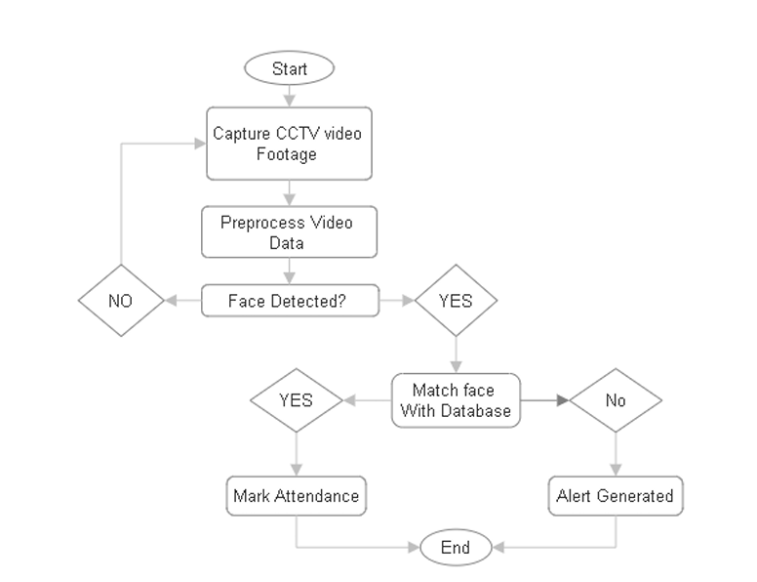
5. Flowchart
Department of AIML Engineering, LoGMIEER, Nashik
Group_Id : 01

Slide 9

6. Project Requirement specification
Functional Requirements
User Management
Attendance Management
Alerts & Notification
Dashboard & Reports
Database Management
Security & Logging
Non Functiona.l Requirements
Performance Requirements
Reliability & Availabilty
Scalability
Maintainability
Upgradability
16 April 2025
Department of AIML Engineering, LoGMIEER, Nashik
Group_Id : 01

Slide 10
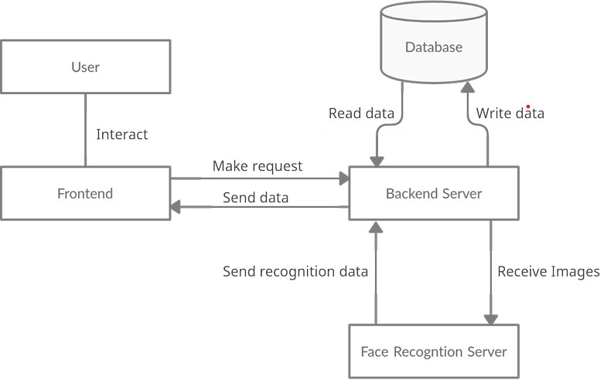
7. Proposed System Architecture

Slide 11
7. High level design of the project (DFD Diagrams).
Attendance marked
Registered User?
Take Images
Match With Database
IF Yes?
Start
Face Matched?
IF No?
New User?
Take Images
Stores In database
Alert Generated..!!

Slide 12
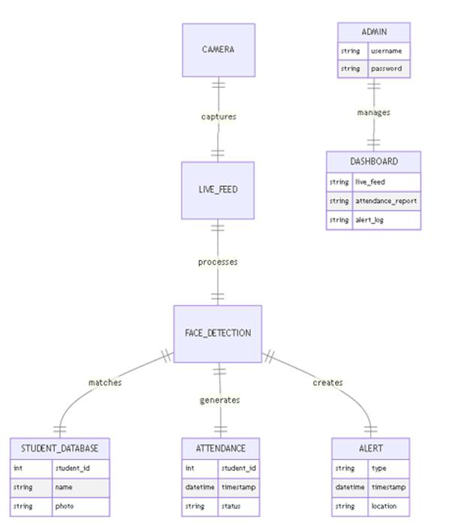
ER

Slide 13
8.Algorithms And Techniques
1. Face Recognition & Classification
-MobileNetV2 (Lightweight CNN for feature extraction)
Softmax Classifier (Multi-class classification)
2. Data Augmentation
Affine Transformations (Rotation, scaling, shearing)
Color Jittering (Brightness adjustment)
3. Training & Optimization
Adam Optimizer (Adaptive learning rate)
L2 Regularization (Prevents overfitting)
Batch Normalization (Stabilizes training)
4. Evaluation & Model Management
Early Stopping (Halts training if no improvement)
ReduceLROnPlateau (Dynamically adjusts learning rate)

Slide 14
9. TEST CASES
TEST CASES
Test Case 1: Data Collection
Test Case 2: Data Preprocessing
Test Case 3: Alert Generation
Test Case 4: User Interaction Logging
Test Case 5: System Response Time
Test Case 6: Ethical Framework Compliance
Test Case 7: System Performance
Test Case 8: System Deployment and User Acceptance

Slide 15
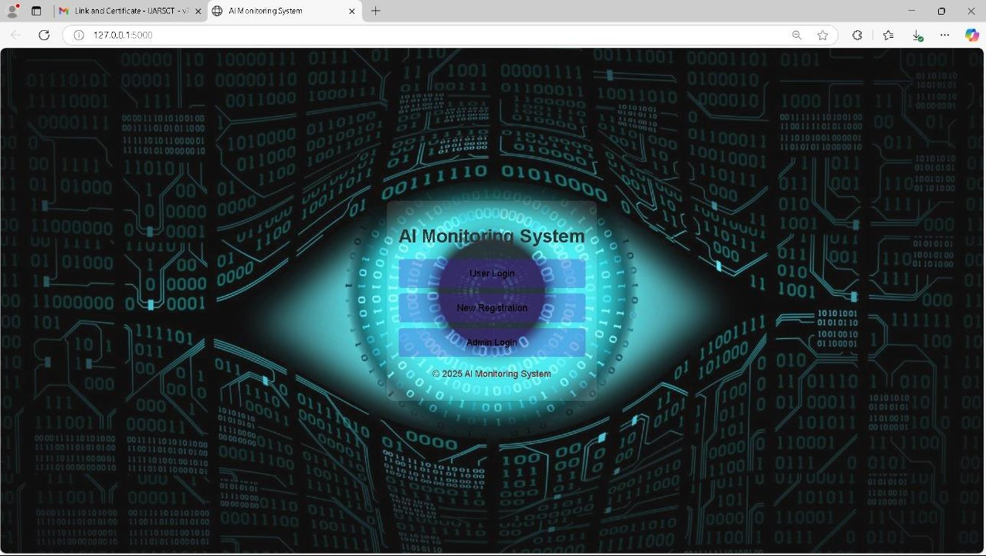
10. Proposed GUI

Slide 16
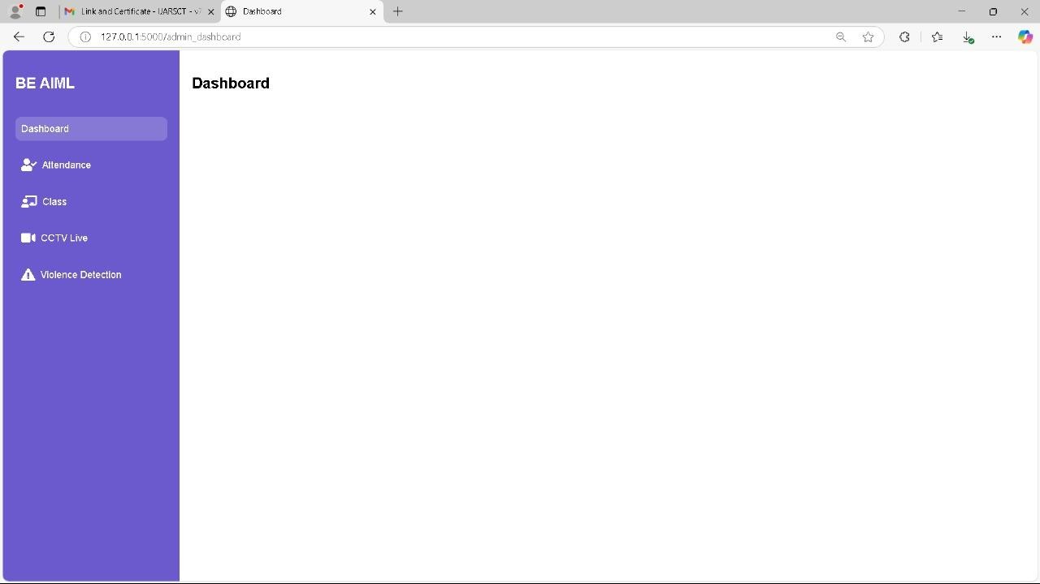
Dashboard

Slide 17

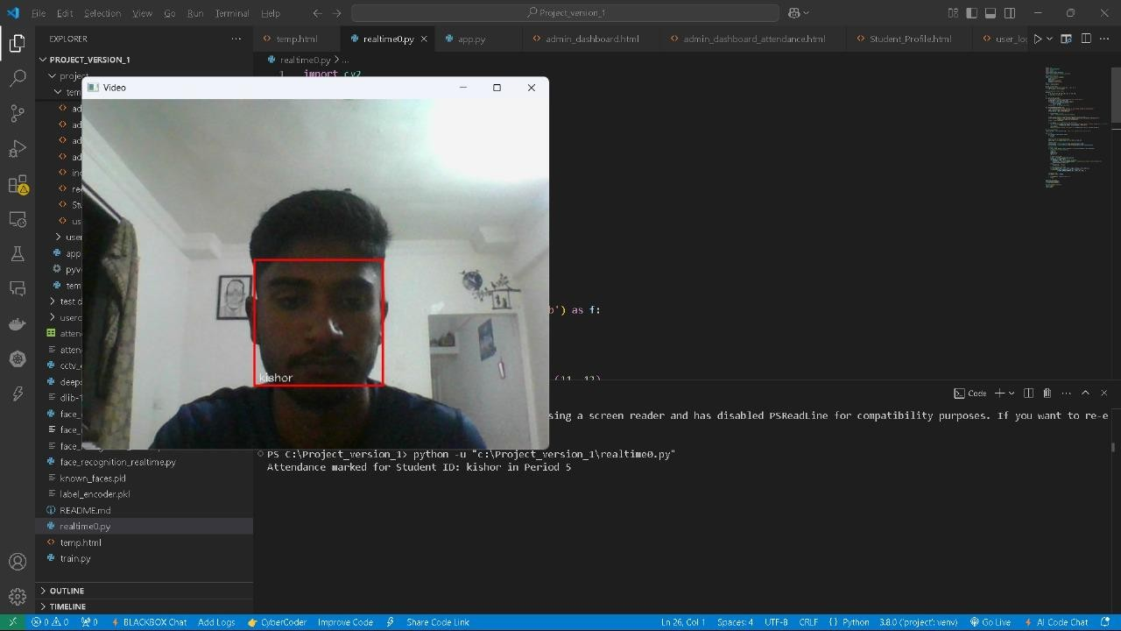
12. Sample Results
16 April 2025
Department of AIML Engineering, LoGMIEER, Nashik
Group_Id : 01

Slide 18


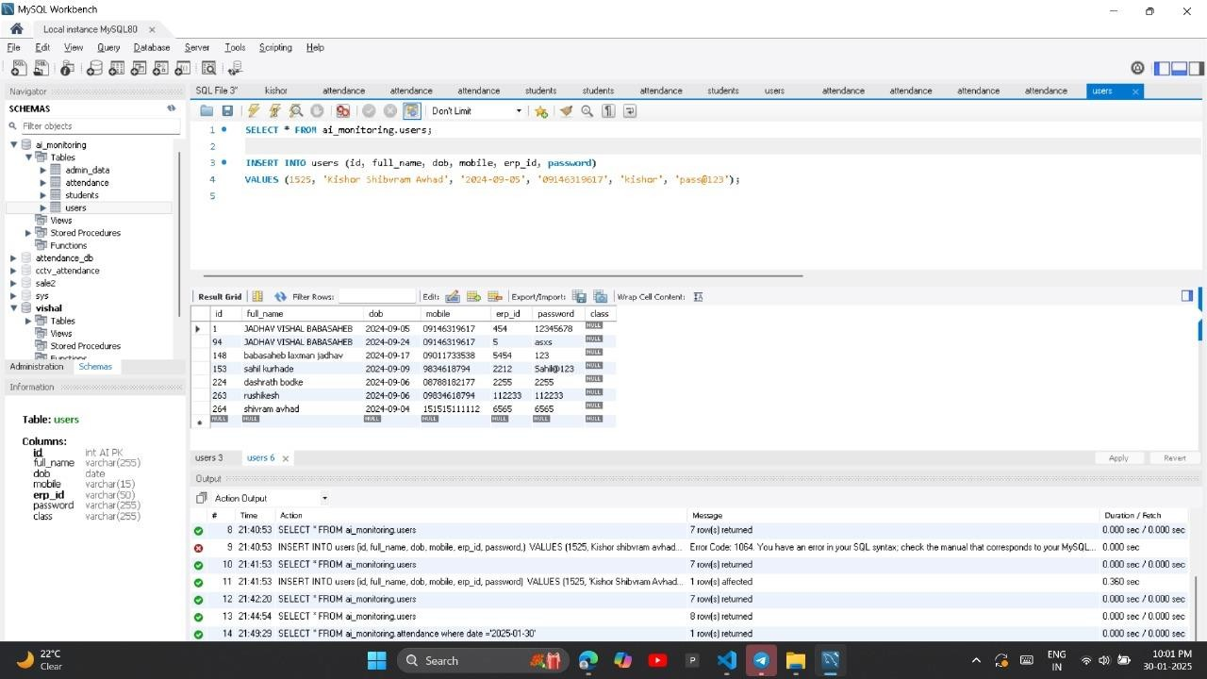
Data Sets
16 April 2025
Department of AIML Engineering, LoGMIEER, Nashik
Group_Id : 01

Slide 19
16.Analysis and Conclusions with future work
Conclusion:
Manual attendance and security systems, burdened by inaccuracy and inefficiency, no longer meet the needs of modern institutions. This project highlights the potential of AI-powered surveillance and smart monitoring to replace outdated practices
with real-time, intelligent solutions. Embracing such technology leads us toward a future rooted in safety, precision, and smarter
institutional management.
19

